Slide 1
MongoDB Builder Fest
Take MongoDB. Add Blockchain. Stir.
June 2019

Slide 2
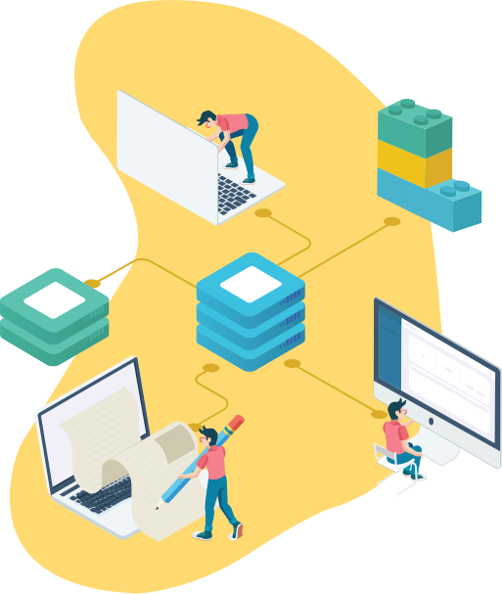
About ProvenDB
Blockchain
ProvenDB bridges the gap between Database and Blockchain technology.
ProvenDB enables the rapid development of high-performance Blockchain applications.
ProvenDB can add Blockchain capabilities to any existing MongoDB application.
MongoDB
ProvenDB

Slide 3


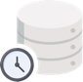



Why it matters
Blockchain
Database
ProvenDB
Blockchain applications typically use the Blockchain both as a data store and a consensus mechanism.
Unfortunately, Blockchain is the world’s worst database: slow, expensive and hard to work with.
Blockchain applications can’t use a traditional DBMS because DBMS lacks immutability of the blockchain.
ProvenDB solves this dilemma.
Tamper Proof
Immutable History
Developer Friendly
Economical
Performant

Slide 4
How ProvenDB Works
ProvenDB
1.
Transactions to ProvenDB are stored (append-only) in the MongoDB database and hashes of the transactions posted to the Blockchain.
MongoDB
Database User
2.
Each transaction creates a new version within the database. The database user or application can explore older versions and their proofs at any time.
Blockchain
3.
The database user requests a proof be placed on the Blockchain for a specific version. This version can be used to prove the timestamp of the entire version or any document in that version.

Slide 5
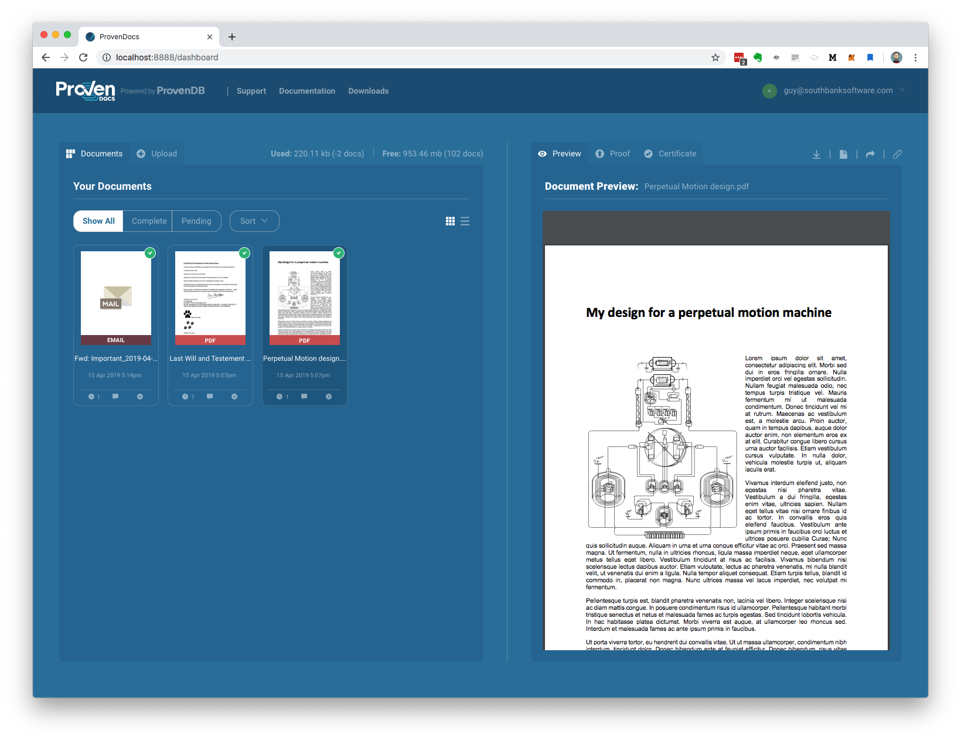
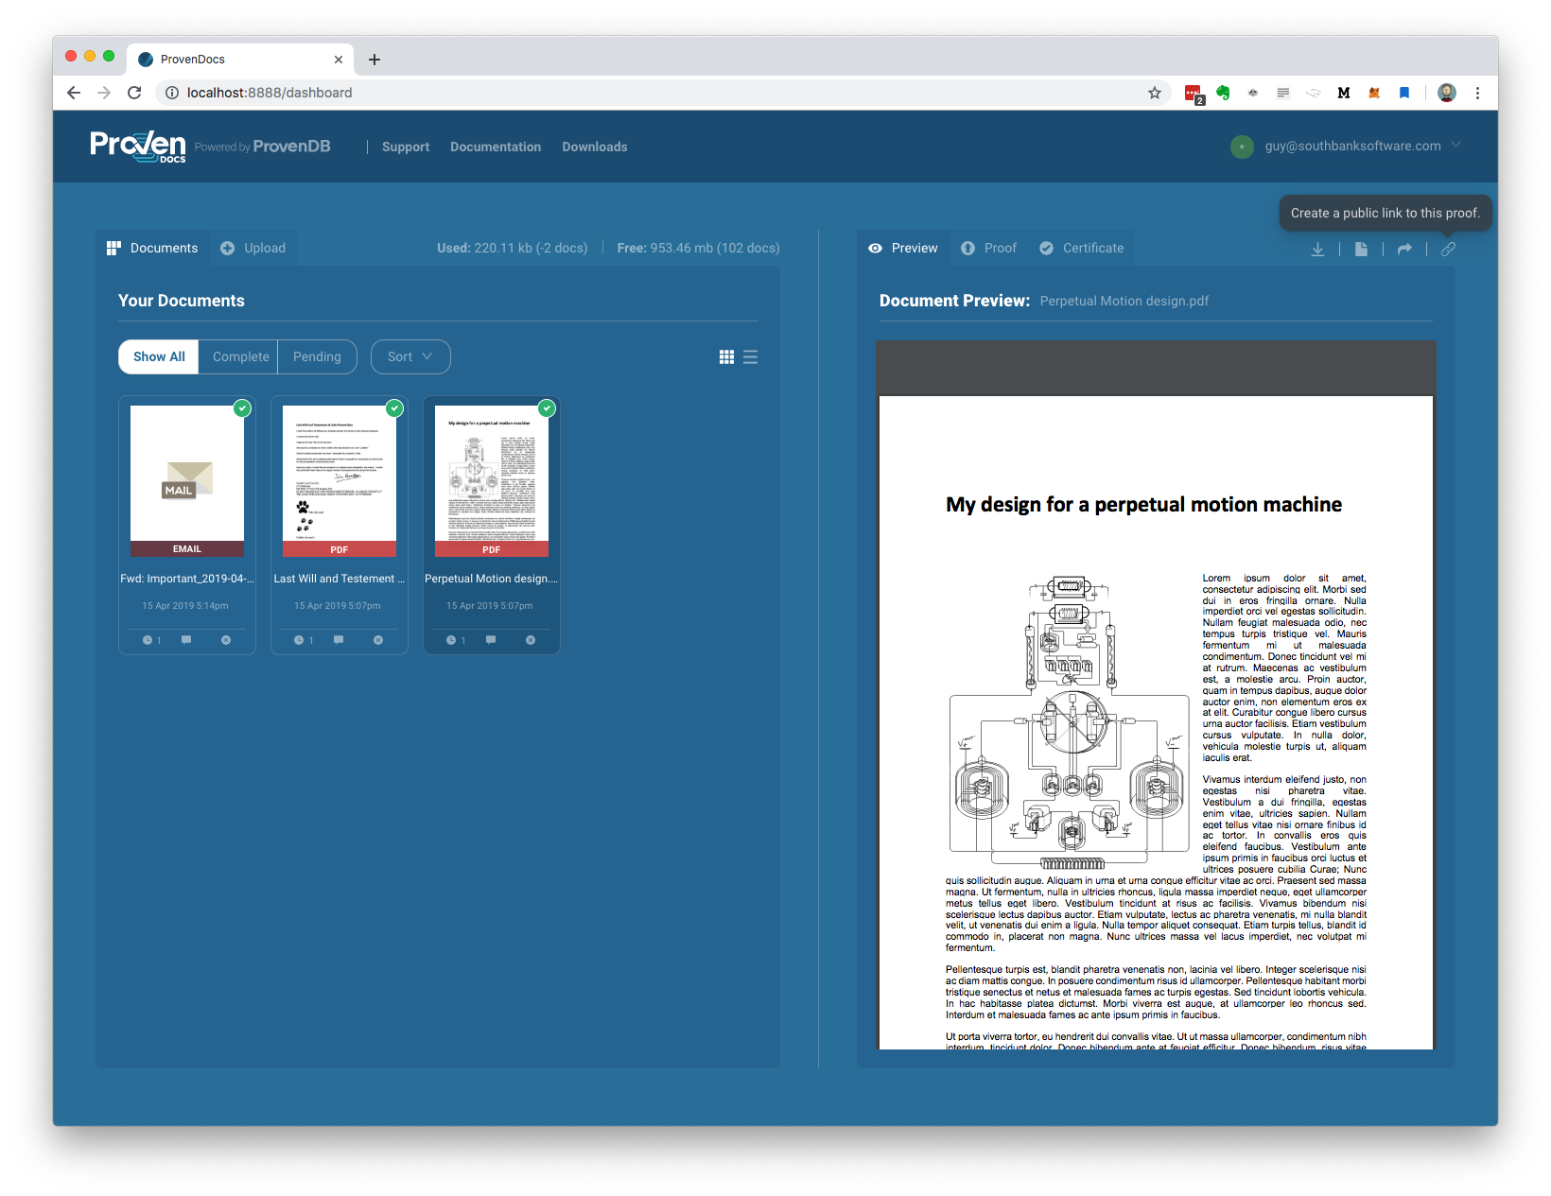
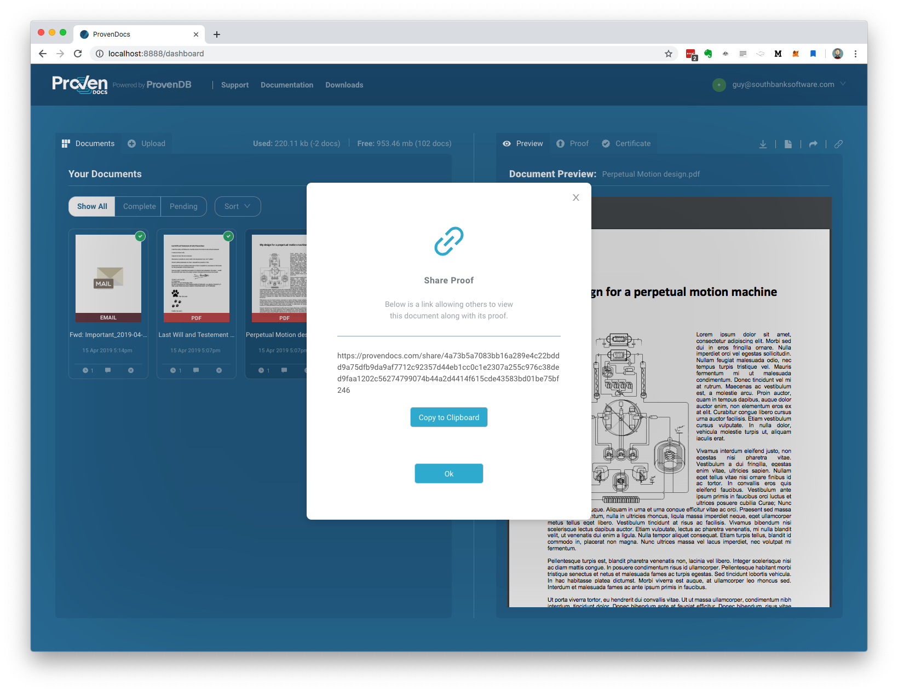
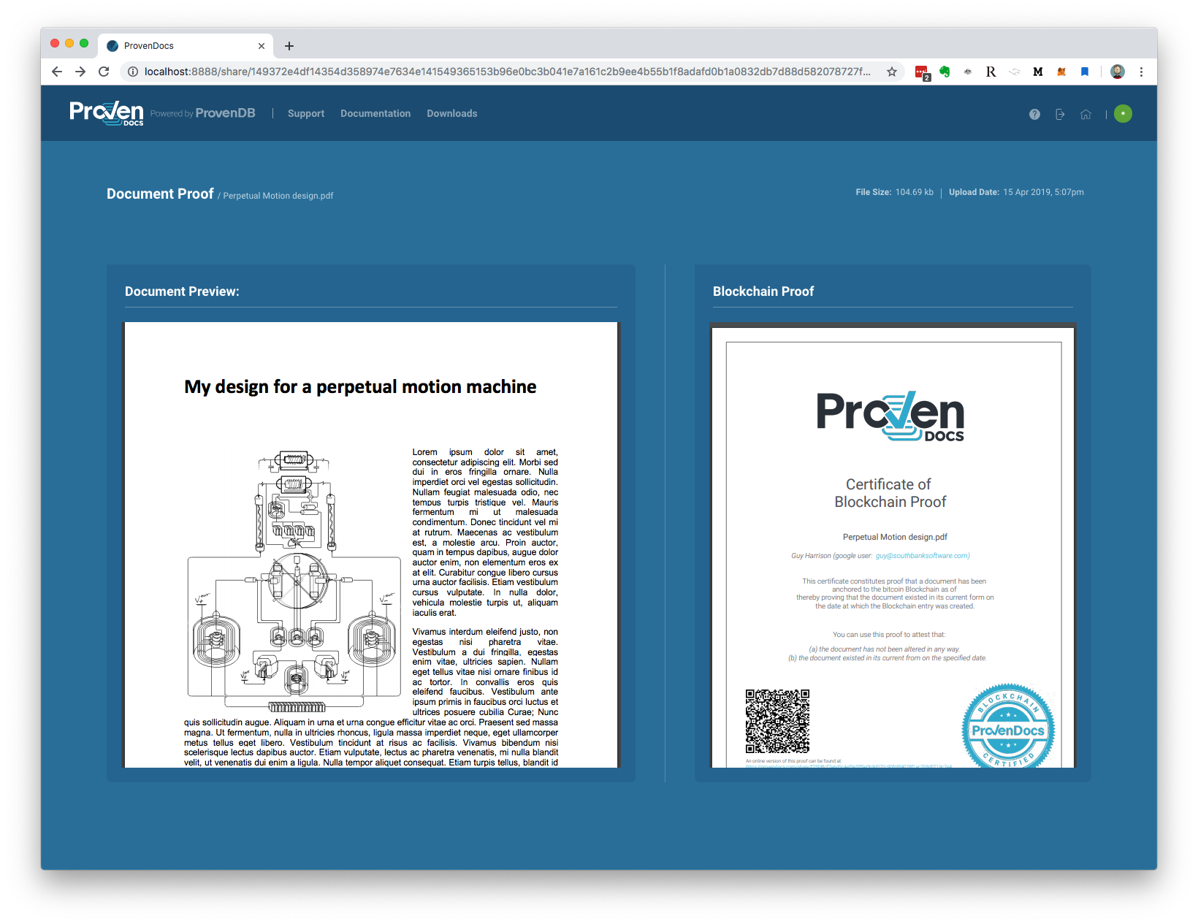
ProvenDocs – A ProvenDB Applications
ProvenDocs.com is a user friendly web application powered by ProvenDB. It allows users to upload their personal documents and receive blockchain proofs of ownership , timestamp and integrity.

Slide 6

Thank You!
Any questions?
Guy Harrison
ProvenDB CTO
(+61) 418 533 988
guy@provendb.com
/guyharrison
/guyharrison

